Slide 1
Azure Backup Overview
PRESENTER NAME
(Updated 1/2023)

Slide 2
Azure Backup Overview
Azure Backup Use Cases
General Terminology
Azure Primitives Review
Azure Storage Basics Review
Azure Backup Architecture
Azure Backup Terminology
Backing up Azure VMs
Backing up Azure Storage - Blobs
Backing up Azure Storage – File Shares
Azure Backup Security
Azure Backup Monitoring
Azure Backup Pricing
Design Considerations

Slide 3
Azure Backup Use Cases
Backup Azure Virtual Machines
Backup Azure Managed Disks
Backup Azure Blobs
Backup Azure File Shares
Backup on-premises machines
Backup SQL Server running on Azure VM
Backup SAP HANA Database
Backup Azure Database Postgre SQL Server
AVS Virtual Machines (Preview)
Azure Kubernetes Services (Preview)

Slide 4
General Terminology
Business Continuity
How an organization maintains critical business operations during and after a disaster
Disaster Recovery
Component of business continuity that is focused on restoration of critical IT applications and data after a catastrophe
Recovery Time Objective (RTO)
Maximum length of time it should take to restore normal operations following an outage
Recovery Point Objective (RPO)
Maximum amount of data the organization can tolerate losing

Slide 5
Azure Primitives
Geography (AKA geopolitical region)
Collection of one or more regions that are grouped for the purposes of specific data residency and compliance requirements
Region
Collection of datacenters within a latency-defined perimeter
Paired Regions
Set of Azure regions that provide out-of-the-box cross-region replication or recovery capabilities for services like Azure Storage, Azure Key Vault, and others
No SLA provided for cross-region replication
Availability Zone
Physically separate locations that are fault tolerant to local failures
Round-trip latency of less than 2ms
Composed of one or more datacenters equipped with independent power, cooling, and networking
Not available in all regions

Slide 6
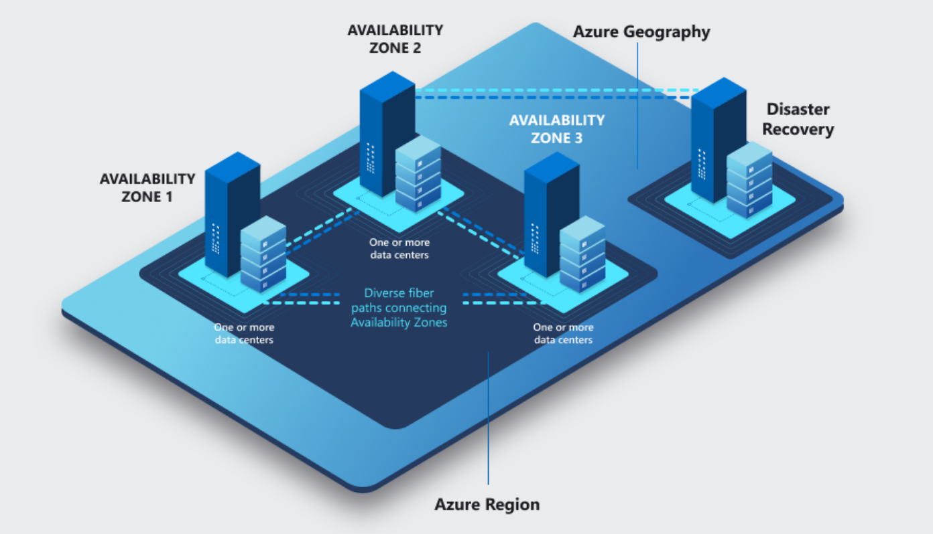
Azure Primitives

Slide 7
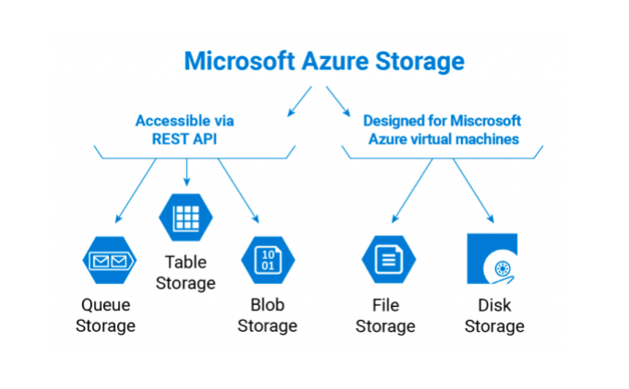
Azure Storage Basics – Storage Account
Atomic unit for storage in Azure
Carved out storage available over multiple protocols (HTTP, SMB, NFS, etc)
Defined set of IOPS and throughput available to all resources within storage account
Many types of storage accounts optimized for specific uses
Multiple redundancy options including LRS, ZRS, GRS, RA-GRS, RA-GZRS

Slide 8
Azure Storage Basics
Locally-redundant Storage (LRS)
Azure storage redundancy option where data is synchronously replicated three times within a single physical location
11x9s durability within a given year
Lowest cost
Zone-redundant Storage (ZRS)
Azure storage redundancy option where data is synchronously replicated across three Azure availability zones
12x9s durability within a given year
Not supported in all Azure regions

Slide 9
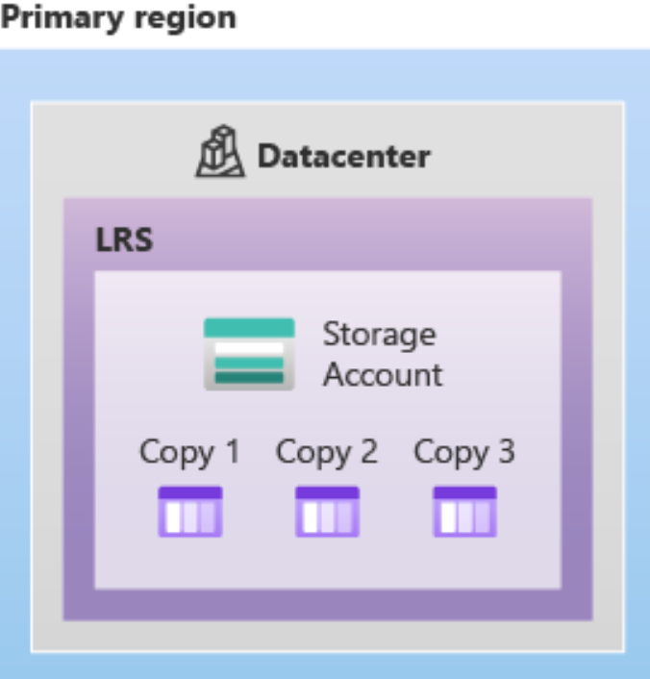
Azure Storage Basics - LRS

Slide 10
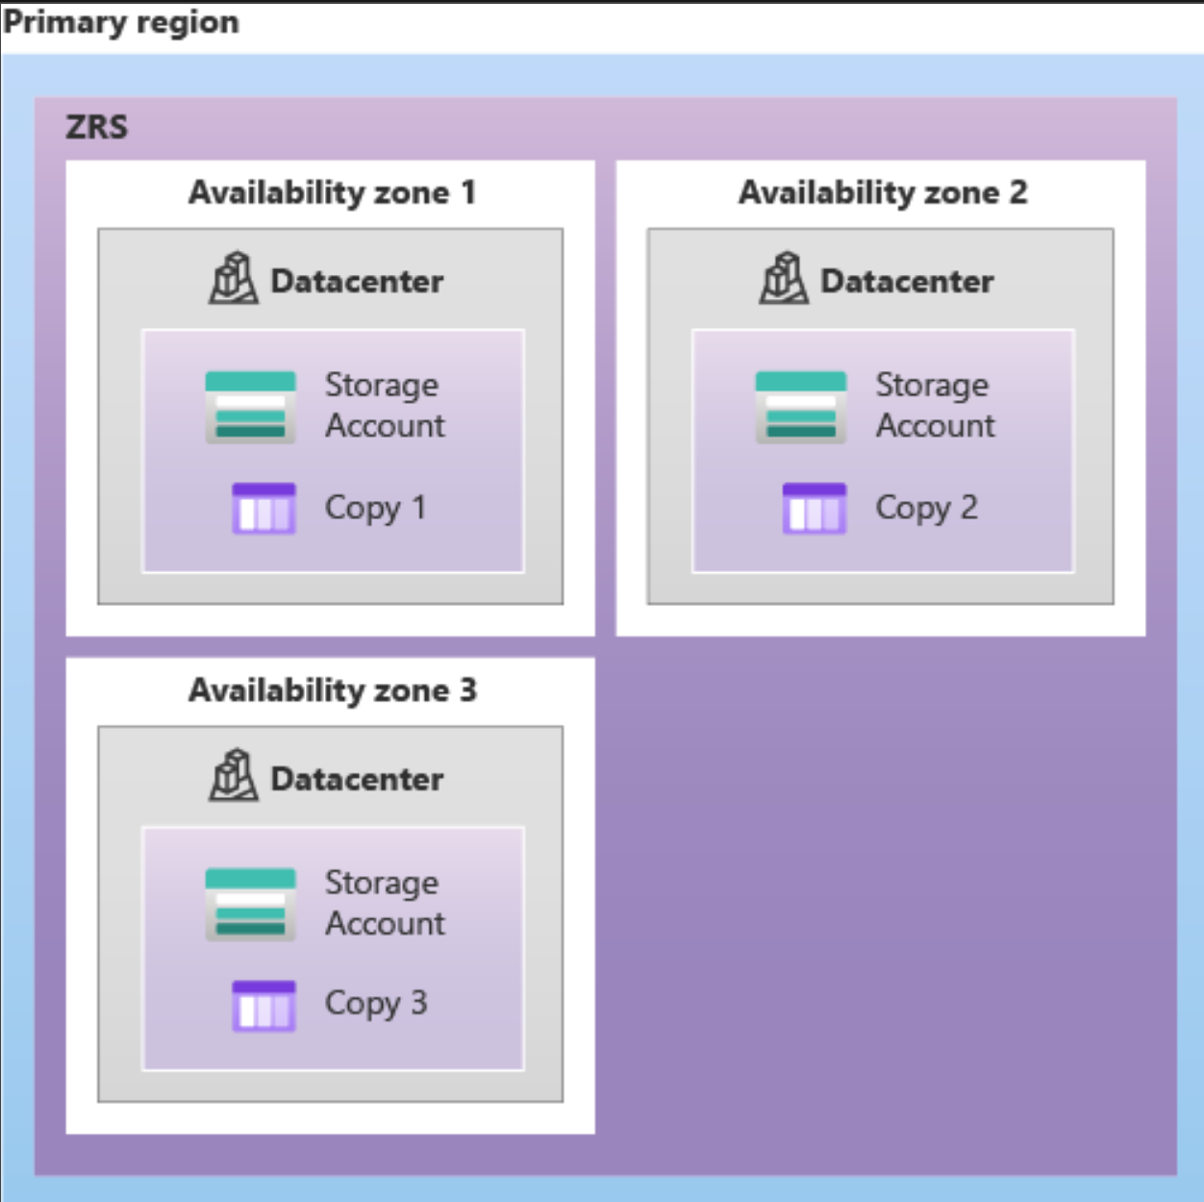
Azure Storage Basics - ZRS

Slide 11
Azure Storage Basics
Geo-redundant Storage (GRS)
Azure storage redundancy option where data is synchronously replicated three times in the primary region using LRS after which data is asynchronously replicated to a second region
16x9s durability over a given year
Geo-redundant Storage (GZRS)
Azure storage redundancy option where data is synchronously replicated across three Azure availability zones in the primary region using ZRS after which data is asynchronously replicated to a second region
16x9s durability over a given year
Not supported in all Azure regions
Geo-redundant Storage (RA-GRS/RA-GZRS)
Same as GRS but makes the data available for read in the second region
* No SLA on how long it takes to replicate data to the second region

Slide 12
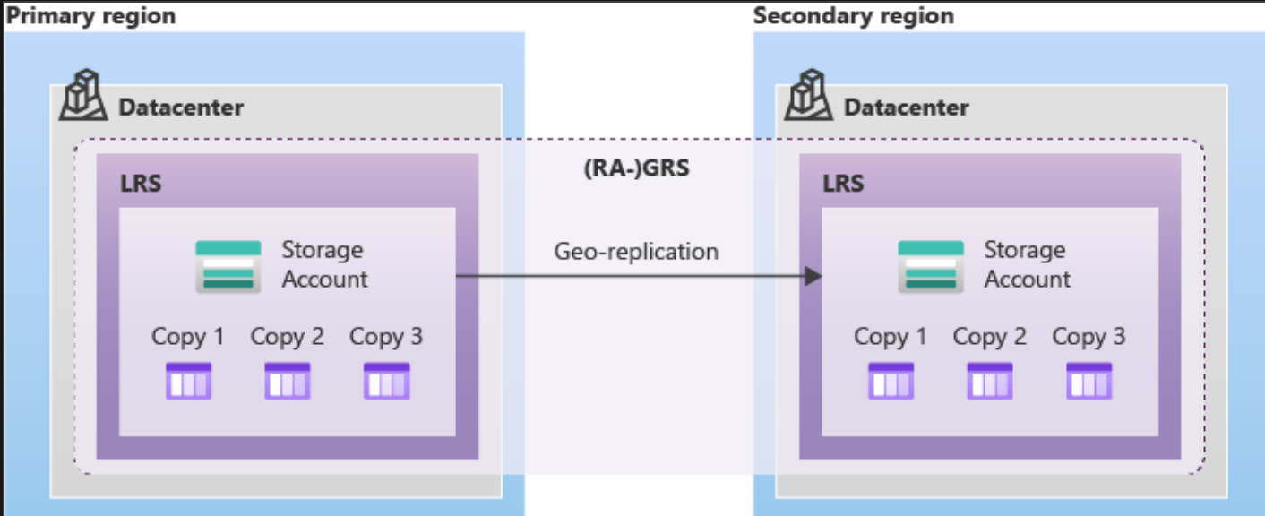
Azure Storage Basics - GRS

Slide 13
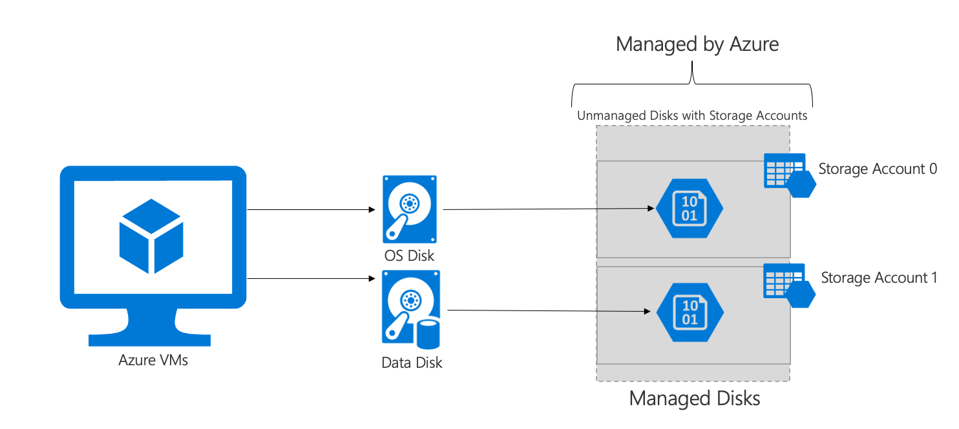
Azure Storage Basics – Managed Disk
Block-level storage volumes
Multiple flavors that vary in performance
Allow for crash-consistent snapshots

Slide 14
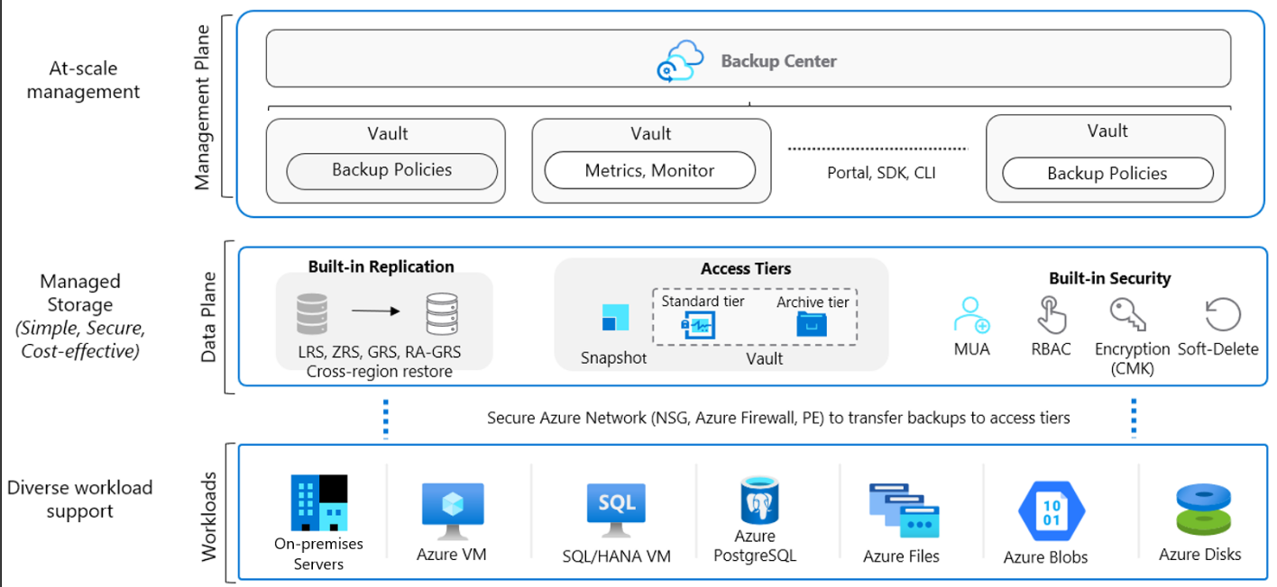
Azure Backup Architecture

Slide 15
Azure Backup Terminology
Application Consistent Backup
Captures memory content and pending writes are captures as part of the backup (think databases)
Application is informed a backup is occurring so changes in memory are written to disk
Windows – Volume Shadow Copy Service (VSS)
Linux – Customer scripted
Crash-Consistent Backup
Snapshot taken of all files at the same time (think of a system being suddenly powered off)
Application data still in memory is not captured
Backup Policies
Define frequency, retention, and sometimes other properties of the backup (such as compression or tiering)
Administer in Azure Backup Center and created on a per vault basis

Slide 16
Azure Backup Terminology
Recovery Services Vault
Regional Azure resource which holds copies of backups, recovery points, backup policies, and recovery policies for both Azure Backup and Azure Site Recovery
Azure VMs, SQL in Azure VMs, Azure Files, SAP HANA in Azure VM, Azure Backup Server, Azure Backup Agent, Microsoft Data Protection Manager (DPM)
Backup Vault
Regional Azure resource which hold backup copies and policies for Azure Backup
Azure Database for PostgreSQL servers, Azure Blobs, Azure Disks, Azure Kubernetes Service (Preview), AVS Virtual Machine (Preview)
Restore Point collection
Collection of restore points for which a virtual machine can be restored to including snapshots and vaulted restore points
Operational, Standard, and Archive Tiers
Different tiers offered by Azure Backup to provide customers with options based on the workloads RTO/RPO
* Vaults can be LRS, GRS (Default), or ZRS (Preview for Backup Vaults)

Slide 17
Azure Backup Terminology
Backup Center
Centralized management point for management of backups
What is backed up (resources), when it is backed up and how long it is retained (backup policies), what was backed up (metrics, alerts, jobs, reports), is everything backed up the way I want it (Azure Policy)
Microsoft Azure Recovery Services VM Snapshot Extension
Extension that is installed on Azure Virtual Machines that is used to create snapshots of the Virtual Machine prior to being transferred to the Recovery Services Vault
Microsoft Azure Recovery Services Agent (MARS)
Agent installed on on-premises or Azure Virtual Machines running Microsoft Windows and enables backup of files, folders, and system state
Notes:
Simple configuration and management
Microsoft Azure Backup Service integrates with the familiar Windows Server Backup utility in Windows Server, the Data Protection Manager component in System Center and Windows Server Essentials, in order to provide a seamless backup and recovery experience to a local disk, or to the cloud.
Block level incremental backups
The Microsoft Azure Backup Agent performs incremental backups by tracking file and block level changes and only transferring the changed blocks, hence reducing the storage and bandwidth utilization. Different point-in-time versions of the backups use the storage efficiently by only storing the changed blocks between these versions.

Slide 18
Azure Backup Terminology
System Center Data Protection Manager (DPM)
Enterprise backup solution that is part of the System Center suite of products
Backup on-premises physical servers, VMs, SQL Server, Microsoft Exchange, SharePoint
Microsoft Azure Backup Server (MABS)
Server-based product that can be used to back up on-premises physical servers, VMs, and applications
Based on DPM and does not require a System Center license
Backup on-premises physical servers, VMs running on Hyper V and VMWare hypervisors, SQL Server, Microsoft Exchange, SharePoint, Azure Stack HCI
Notes:
Simple configuration and management
Microsoft Azure Backup Service integrates with the familiar Windows Server Backup utility in Windows Server, the Data Protection Manager component in System Center and Windows Server Essentials, in order to provide a seamless backup and recovery experience to a local disk, or to the cloud.
Block level incremental backups
The Microsoft Azure Backup Agent performs incremental backups by tracking file and block level changes and only transferring the changed blocks, hence reducing the storage and bandwidth utilization. Different point-in-time versions of the backups use the storage efficiently by only storing the changed blocks between these versions.

Slide 19
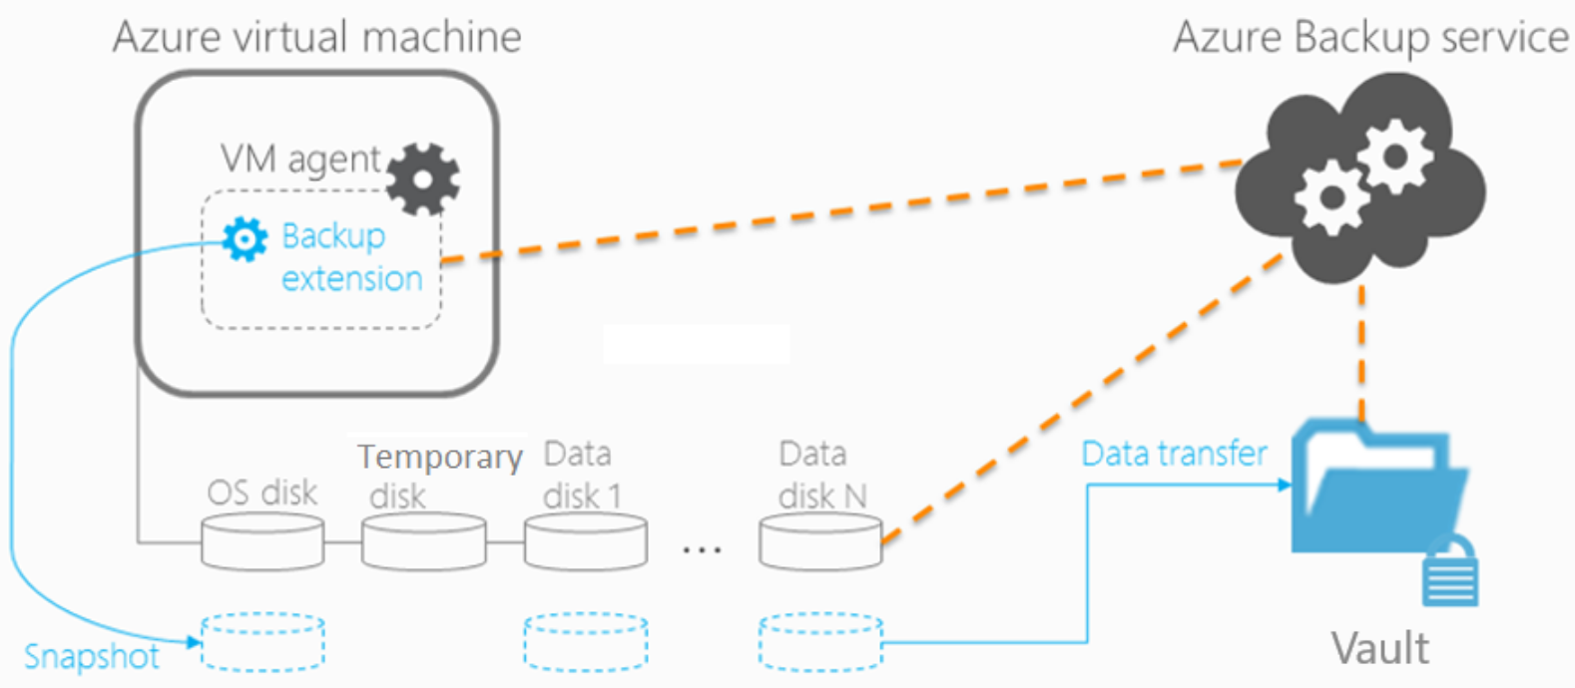
Backup/Restore Azure VMs – VM Snapshot Extension
Uses a VM extension which is automatically installed during the first backup
Backup of all attached disks are performed in parallel
Snapshots are incremental and recovery points are created for each backup
Supports VMs encrypted with SSE and ADE
Snapshots of the virtual machine are taken and transferred to the Recovery Services Vault
Transfer of snapshots to the vault may take up to 24-hours
Restore to a new VM, a disk, replace an existing VM, or restore to the paired region (if using Cross Region restore)
Supports daily, weekly, monthly, and yearly backup points

Slide 20
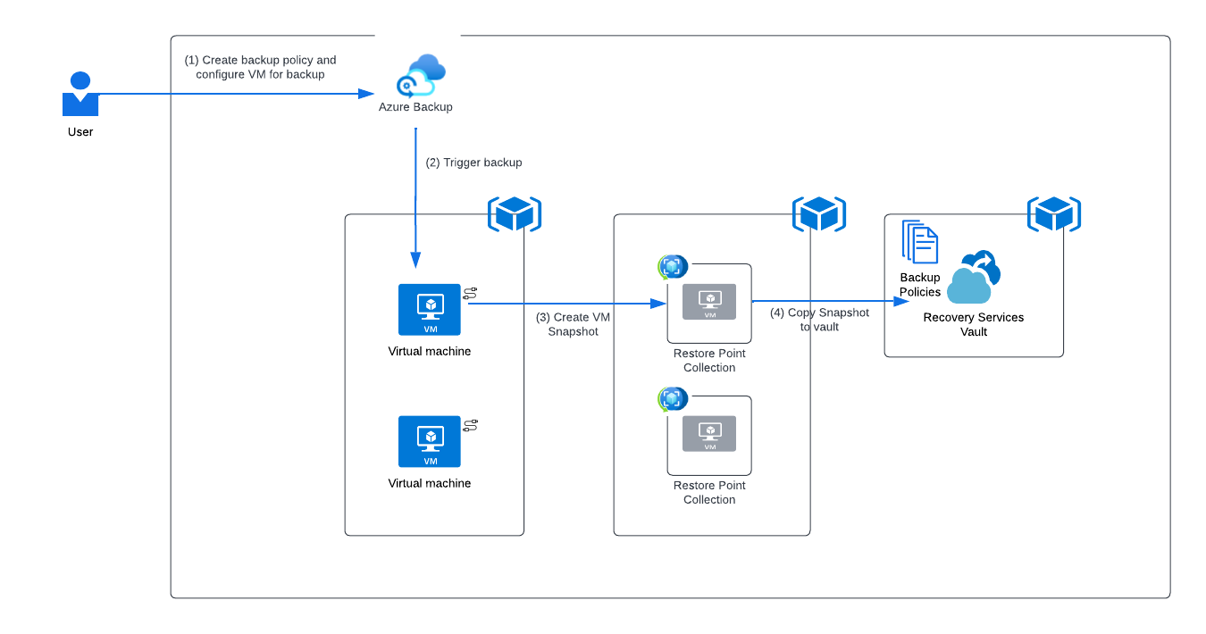
Backup/Restore Azure VMs – Backup Process

Slide 21
Backup/Restore Azure VMs – Instant Restore
Snapshots taken as part of the backup process are retained for a time in the operational tier* (as a snapshot) and can be used in place of a restore point stored in the Recovery Services Vault to shorten the time required for the restore process
Restores can be performed to a new virtual machine or to new managed disks or replace existing managed disks
Requires a storage account for temporary storage during the restore process
* Azure Backup has three tiers of storage which include operational tier (prior to transfer to vault), standard tier (stored within the vault), and archive (long term storage)
Notes:
Archive Store only stores full backups and takes much longer to restore from, but it is cheaper for high churn VMs

Slide 22
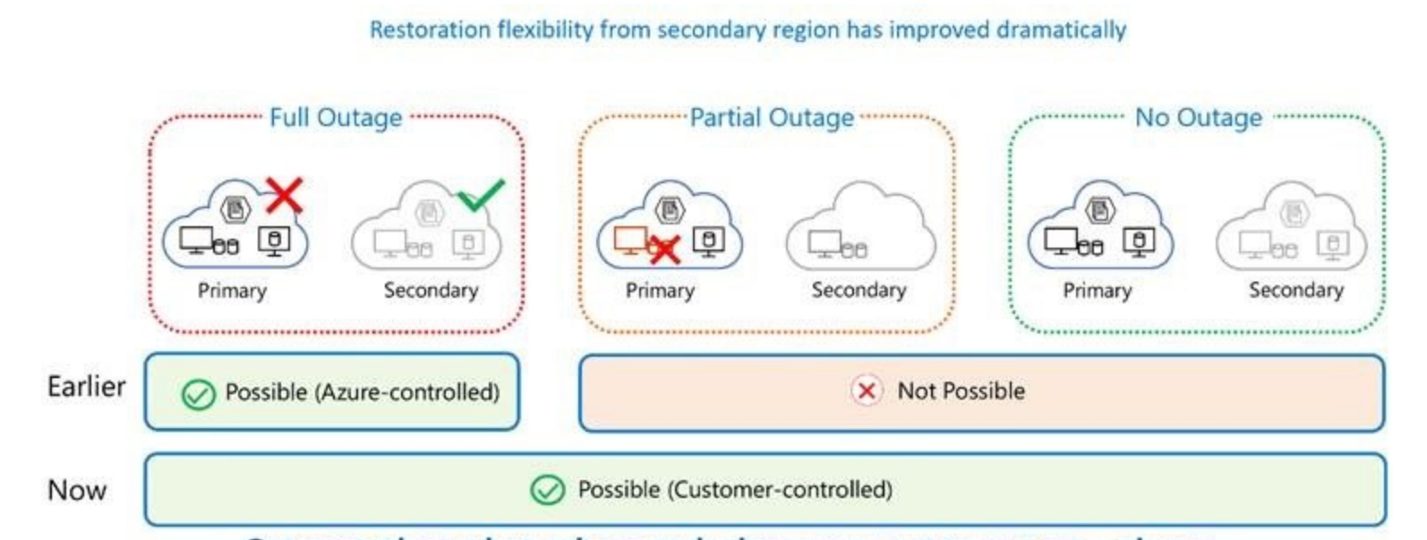
Backup/Restore Azure VMs – Cross-Region Restore
Allows you to restore data for backed up Azure VMs and SQL/SAP HANA databases to the secondary paired region in the same subscription
Requires the Recovery Services Vault be enabled with GRS replication
RPO of 36 hours
Supports scenarios where customer wants to test its ability to restore from a backup

Slide 23
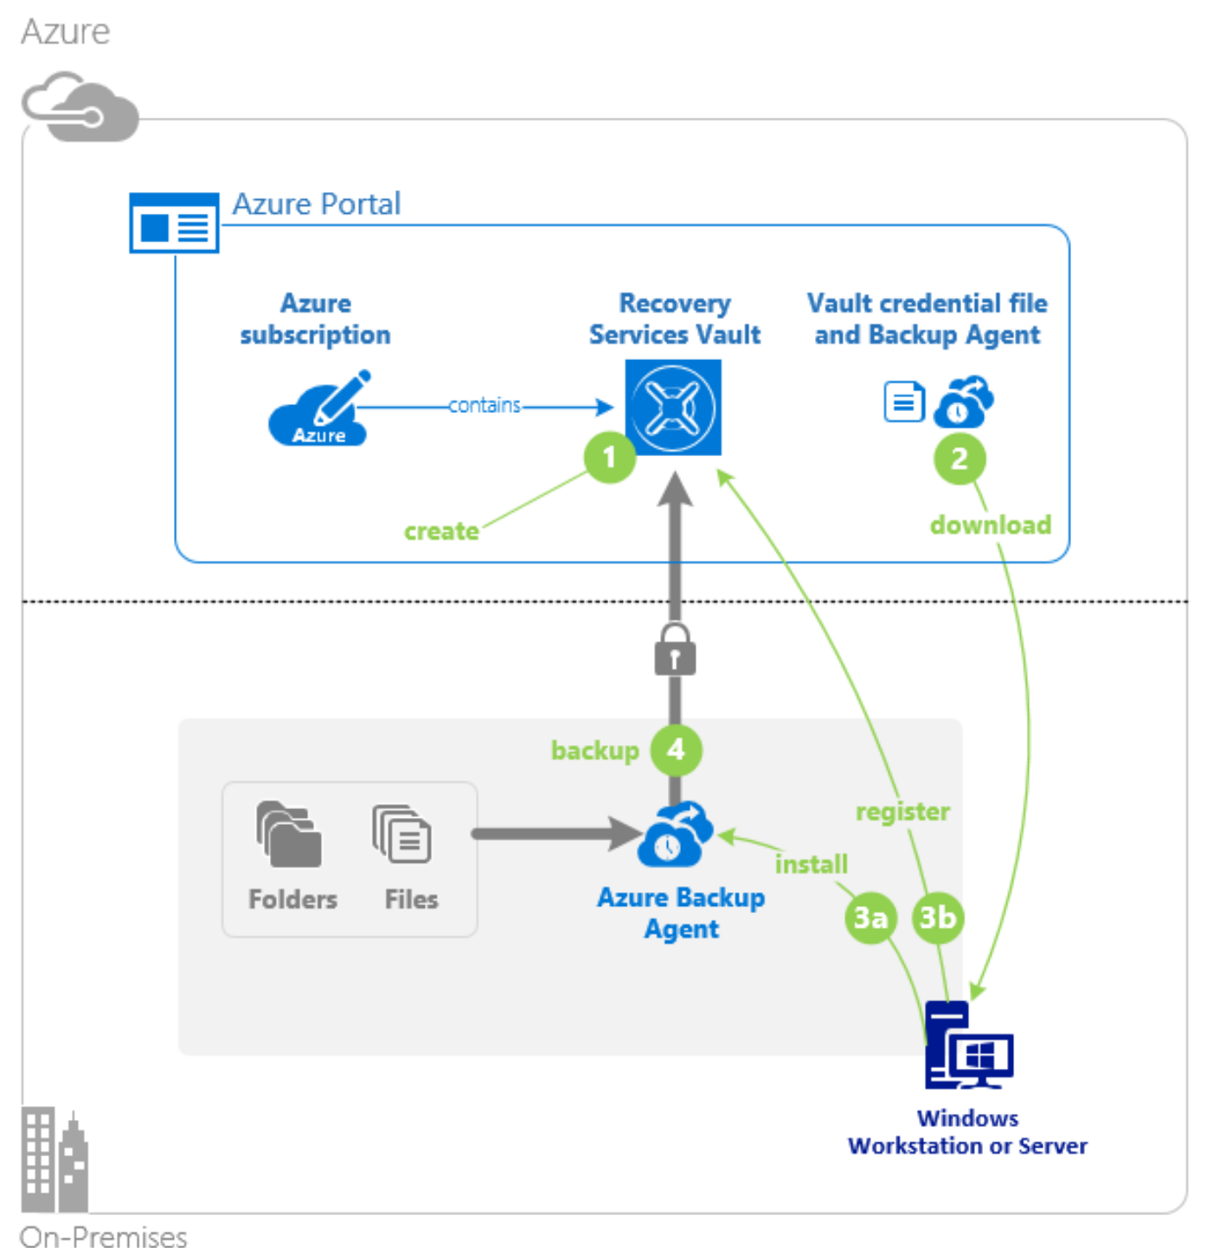
Backup/Restore Azure VMs– MARS Agent
Agent-based backup which can supplement the extension-backup by providing more recovery points for individual files or folders
Individual files and folders can be restored
Requires more overhead due to agent deployment such as allowing specific network traffic to the Azure management plane

Slide 24
Backup/Restore Azure VMs – Disk Backup
Agentless solution that can be used in combination with Azure VM Backup when there is a requirement to have crash-consistent backups created more than once a day
Uses incremental snapshots capability of managed disks
Azure Backup maintains snapshots based upon the retention within the backup policy
Backup Vault used to store the backup policy but the snapshots themselves are never stored in the Backup Vault and instead stored as resources in a resource group
Backup Vault uses a managed identity to access other Azure resources such as the source managed disk and snapshots
While Backup Vault can be stored in a different subscription, the snapshots taken must be stored in the subscription the resource exists in
Restore the snapshots to a new managed disk in a new resource group (overwriting existing disk is not supported at this time)

Slide 25
Backup/Restore Azure VMs – Immutable Vaults and Resource Guard
Immutable Vaults
Block deletion of backups and modification of retention times
Reversible and irreversible
Resource Guard
Allows you to protect risky operations against a Recovery Services Vault such as stopping backup protection or disabling soft delete
Resource Guard resource can exist in the same subscription, a different subscription, or a different tenant
Modification of the protected settings on the Recovery Services Vault will require Contributor on Resource Guard resource
Can be used in combination with immutable vaults to assist with satisfying compliance requirements and create separate authorization blast radius

Slide 26
Backing up Azure VMs - Feature Matrix
Options | Benefits | Considerations | What is protected? | Where are backups stored?
Azure VM Snapshot Extension | Native backups for Windows/Linux No specific agent installation required Supports both application-consistent and crash-consistent backups Supports instant restore | Restore VMs at disk-level only Backup 1x a day only (multiple backups/day in preview) Application-consistent backups of Linux VMs requires customer scripts | VMs, All disks | Azure Resource Group as Restore Point Collection and Recovery Services vault
MARS agent | Backup individual files, folders, and system state Backup multiple times a day | No support for VMs running Linux Crash-consistent backups only Agent-based | Files, Folders System State | Recovery Services vault
Disk Backup | No agent or extension is required Create multiple backups a day | Crash-consistent backups only | Managed Disk | Azure Resource group as Managed Disk snapshots

Slide 27
Azure Backup - Azure Storage Blobs
Administer via Backup Center and store policies in Backup Vaults
Backup data is stored in the Storage Account itself and is not transferred to the Backup Vault
Backup policies for blob backup allow you to configure a retention
Uses versioning, point-in-time-restore, soft delete, change feed, and delete lock features of blobs
Blob replication is another option to replicate data for the purposes of DR

Slide 28
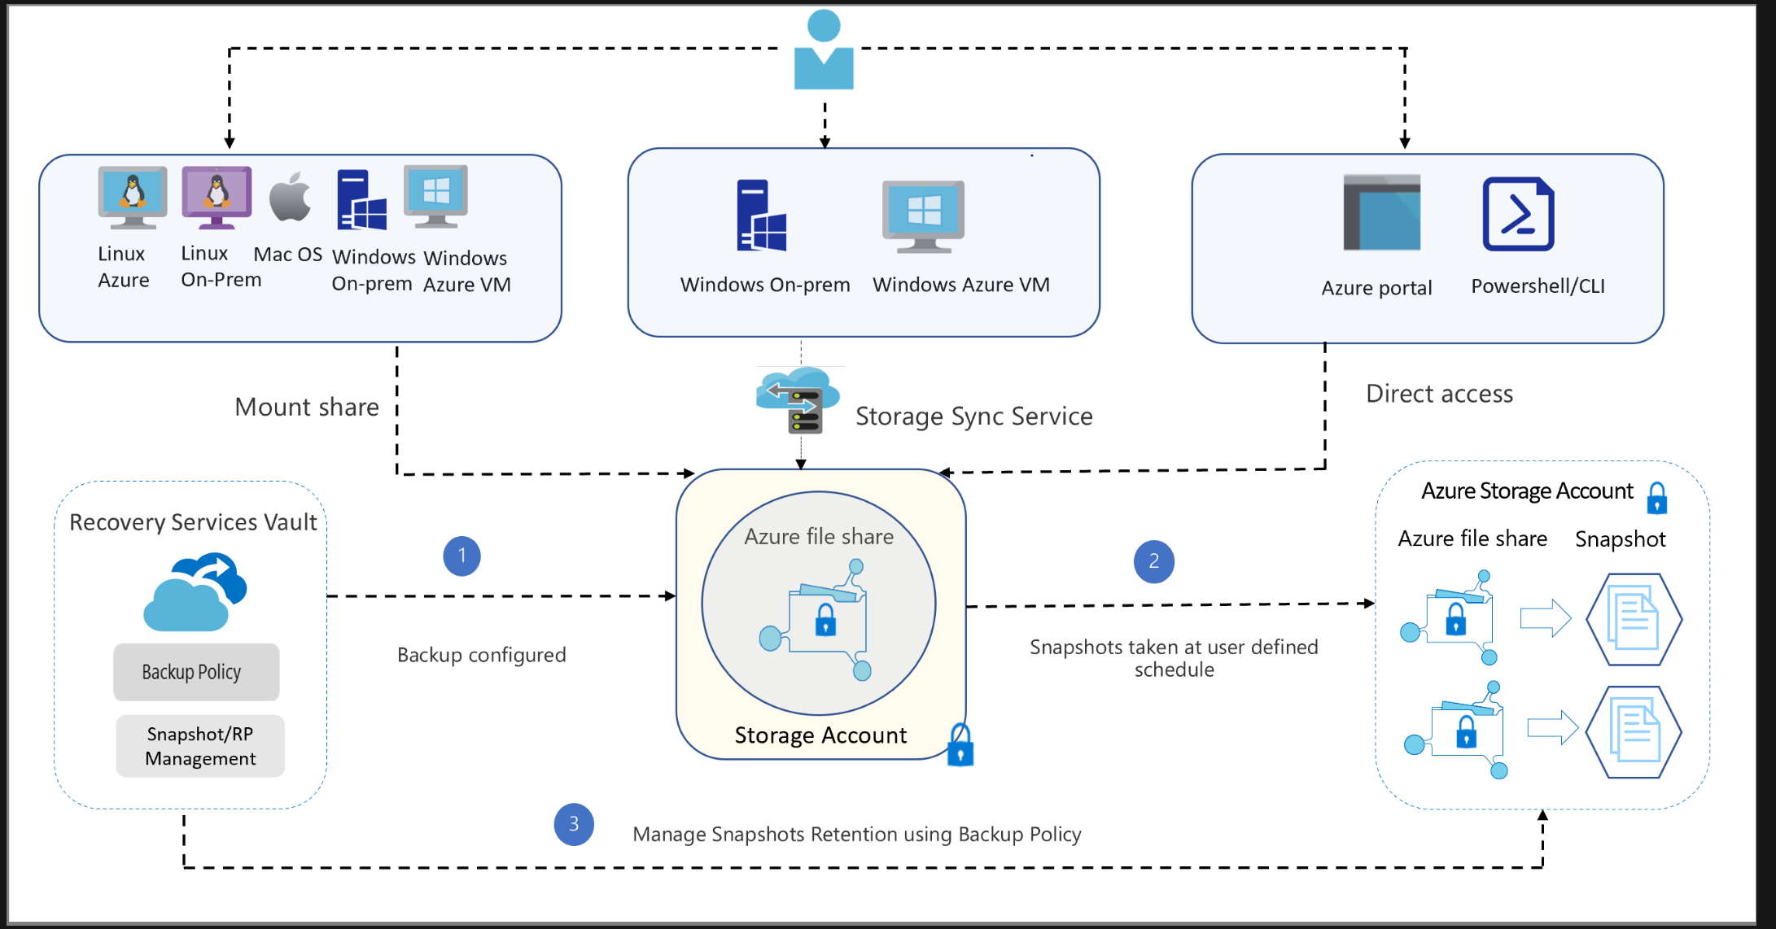
Azure Backup – File Shares
Administer via Backup Center and store policies in Backup Vaults
Backup data is stored in the Storage Account itself and is not transferred to the Recovery Services Vault
Allows for daily, weekly, monthly, yearly retention
Restore individual files or entire file shares
Uses soft delete and snapshot features of Azure Storage Accounts
NFS shares are not yet supported

Slide 29
Azure Backup - Security
Authorization
Azure RBAC
Resource Guard for multi-user authorization
Soft-delete
Immutable vaults*
Networking
Private Endpoints are supported for Azure Backup
Encryption-in-transit
All data transit between Azure Storage remains within the Azure network and the vault is protected by HTTPS
Encryption-at-rest
All data is automatically protected using Provider-managed keys (PMK) and can optionally be encrypted using Customer-managed keys (CMK)
Supported to backup VMs encrypted with Storage Service Encryption (SSE) w/ CMK or Azure Disk Encryption
* Immutable vaults are in public preview as of 1/2023

Slide 30
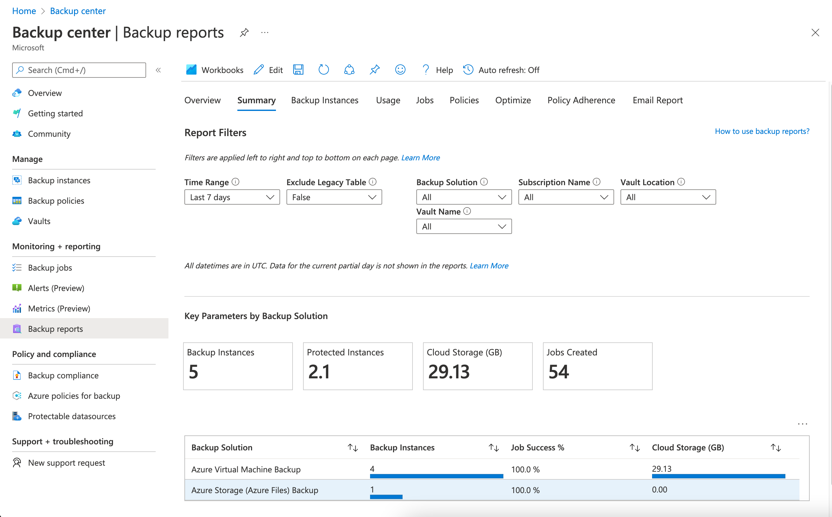
Azure Backup - Monitoring
Centrally monitor Azure Backup using Backup Center
Integrated with Azure Monitor which supports creating Azure Alerts
Built-in Reports to show historical trends of backup
Azure Activity Logs provide audit activities for management-plane administration of Azure Backup
Alert on security alerts and job failures

Slide 31
Azure Backup Pricing
Data Processing
Per Instance: An instance is a physical or virtual computer, files and folders or database. The size of the backed-up data determines the pricing for Azure Backup in each protected instance before compression and encryption.
Data Consumed: Data processed and stored by Azure Backup
Data Storage
Data in storage: Charged based upon storage tier (where available) and storage option (LRS, ZRS, GRS, RA-GRS)

Slide 32
Azure Backup – Design Considerations
Know whether you require an application-consistent backup or crash-consistent backup
Combine solutions to ensure your RTO/RPOs can be met
Recovery Services Vault must be created in the same region and subscription as the resource it is backing up.
Backup Vaults must be created in the same region as the resource it is backing up but can be placed in different subscriptions
Keep the number of Recovery Services Vaults and Backup Vaults to a minimum and instead use multiple backup policies to apply different settings to resources
Use separate vaults for different types of workloads (VM vs Azure Files vs MS SQL) which allows you to create different access rules
Use separate vaults for production and non-production
Evaluate whether your older backups make sense for archival backup, the more churn the better

Slide 33
Azure Backup – Design Considerations
Use Resource Guard and/or immutable vaults* to add additional protections to Recovery Services Vaults and help with compliance requirements
Use GRS storage replication for vaults holding mission critical workloads or if you want to use cross region restore functionality
Schedule backups during non-peak application time
If backing up multiple VMs to the same vault, consider staggering the start times
Use Azure Policy if you require consistent backup policy across vaults
Determine if you require Customer Managed Keys (CMKs) for encrypting your backups
* Immutable vaults are in public preview as of 1/2023

Slide 34
Azure Backup – Summary Matrix
Backup Feature | What is backed up? | RPO | RTO | Retention
Azure VMs | Virtual Machines (application consistent and crash consistent) | 24 hours for application-consistent (As low as 4 hours in preview) | Hours for vault tier depending on size Faster for operational tier | Varies for vaulted backups Up to 15 days for operational tier backups
Azure Managed Disks | Managed Disk | As low as 1 hours | Instant | Up to 12 days for daily backups Up to 12 weeks for weekly backups
Azure File Shares | File share and files within | Less than 24 hours a day (maximum of 3 backups a day) | Varies | See documentation

Slide 35
Azure Backup – Summary Matrix
Backup Feature | What is backed up? | RPO | RTO | Retention
Azure Blob Storage | Azure Blobs | Any point-in-time up to maximum retention | Varies | Up to 360 days
Azure MARS | Individual files, folders, system state | As low as 24 hours | Varies | Up to 9,999 days for daily backups See docs for weekly, monthly, yearly

Slide 36
Appendix – Useful Links
Azure Backup Best Practices and Guidance - https://docs.microsoft.com/en-us/azure/backup/guidance-best-practices
Azure CAF BCDR - https://docs.microsoft.com/en-us/azure/cloud-adoption-framework/ready/landing-zone/design-area/management-business-continuity-disaster-recovery

Slide 37
Appendix – Azure Backup Limits
Recovery Services Vaults are limited to backing up 1,000 VMs per vault
Recovery Services Vaults are limited to backing up 2,000 workloads per vault
Recovery Services Vaults can be moved between regions within the same subscription
Backup Policies are scoped to a vault
Resource Locks can be applied to customer-managed resource groups but not the resource groups Azure Backup creates
Archive tier is for data written to the vault and stored for a specific period (https://docs.microsoft.com/en-us/azure/backup/archive-tier-support)

